Slide 1
Gravity Courier
Group #9 - Wyatt Cook, Janeane Westmoreland, Joseph Hammock, Aurelia Deines, Brayden Kielb, Brian Vorac

Slide 2
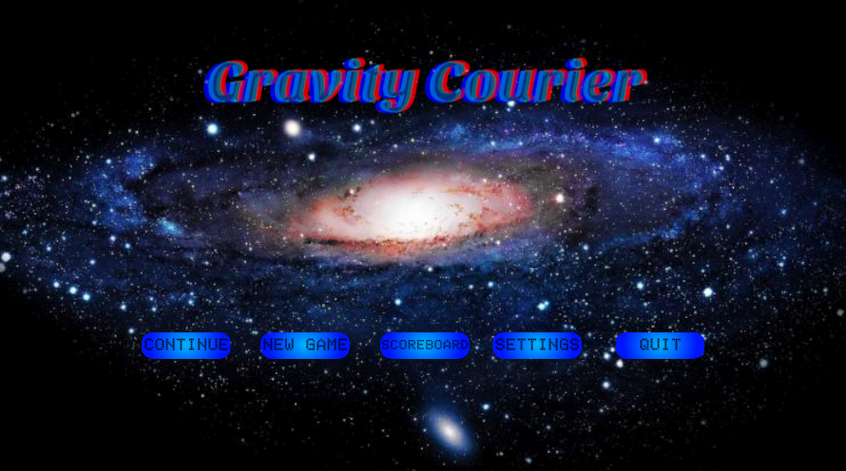
Project Overview
Motivation
Create a short and entertaining space themed 2D-platformer
Challenge players with hazardous environments and difficult platforming
Provide a unique and memorable story for players to engage with
Summary
Gravity Courier is a space themed 2D-platformer built using Unity.
It puts players in the role of a delivery person working to pay off their debt by delivering packages to various planets across the solar system
The game features four different levels, a world map, and custom artwork

Slide 3




Technology Used
Unity
Game engine & game development software
Used as primary development tool
Microsoft Visual Studio
IDE used for coding in various programming languages
Used to code C# scripts for Unity
Clip Studio Paint
Art creation software
Used to create player sprites
Git & GitHub
Collaborative development tool
Used to share project files

Slide 4
Requirements and Specifications Overview
Functional Requirements:
• Core platforming (movement, hazards, scoring)
• Basic enemy AI + level progression
• Limited multiplayer: view other players’ scores
• Credits section listing all assets and sources
Nonfunctional Requirements:
• Tools: Unity, Clip Studio, Visual Studio/VS Code
• Smooth game performance
• Organized project structure + maintained documentation

Slide 5



Software Development Methodology
Kanban
Trello board
Group meetings
Asynchronous communication
Discord
Github

Slide 6
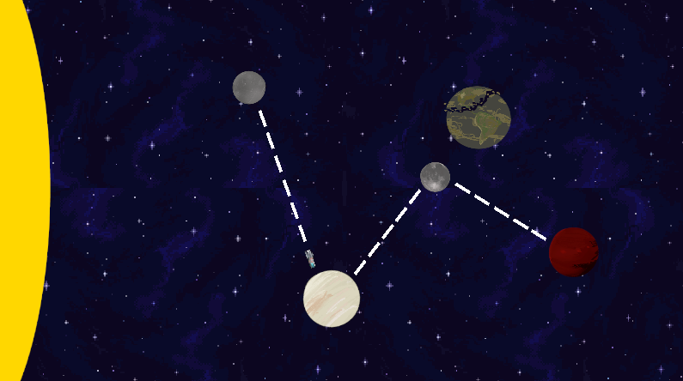
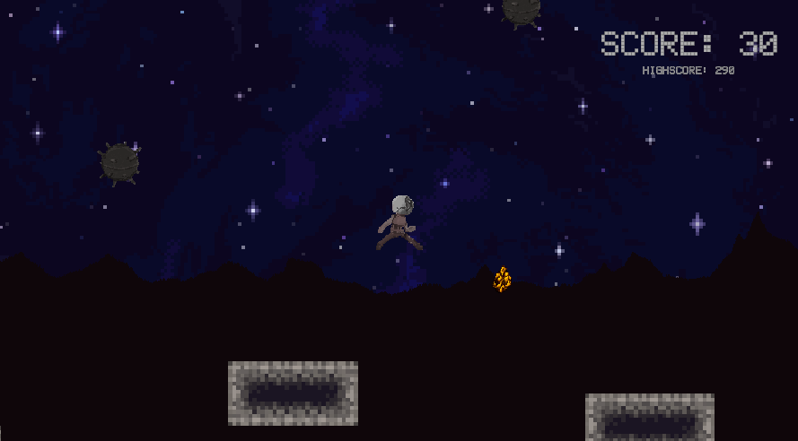
Work Done
Player Scripting
Jumps, double jumps, wall slides, wall jumps
Score System
Main Menu Navigation
Working buttons to transition menus
Take player name input for score system
Four Completed Levels
Mercury, Venus, Moon, Mars
World Map
Sound Effects
Level Start/Exit Animations
Custom Sprites
Player, naval mines, planets

Slide 7
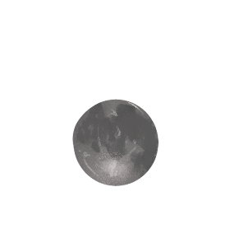
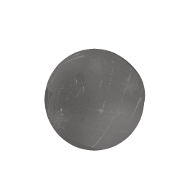

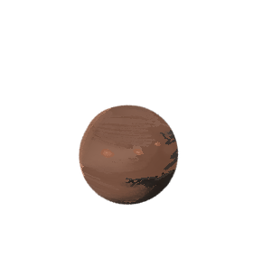
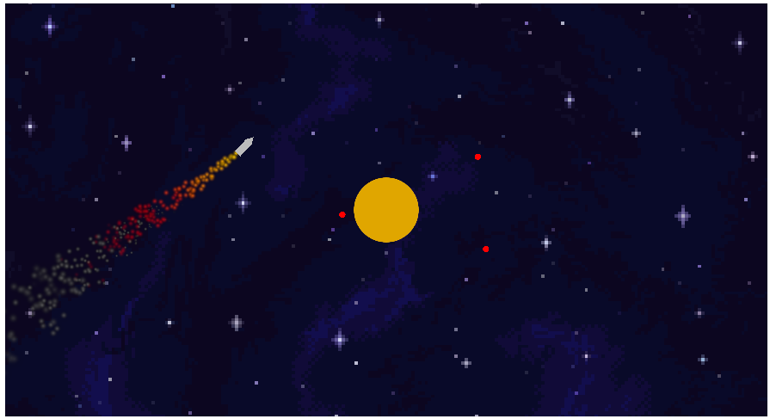
Cut Content
Overall Length
Intended to span 8+ levels
Cut down to 4 due to time constraints
Level Transition Minigame
Wanted player to fly between levels
Decided to go with classic ‘world map’
Ending Sequence
Wanted escape sequence as final stage
Cut due to time constraints

Slide 8
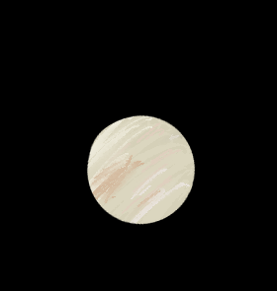


Future Work
More Levels
Create levels for the moons of Jupiter and beyond
Dynamic Enemies/Obstacles
Program hazards that target/react to player
Narrative Expansion & Worldbuilding
Side quests or optional storylines tied to each planet/moon
Environmental storytelling (ruins, logs, visual clues about the past)
Potential multiple endings based on player choices or collectibles
Music
Online Leaderboard
Console/Mobile Support
Conclusion for Main Story

Slide 9
Demo

